Slide 1
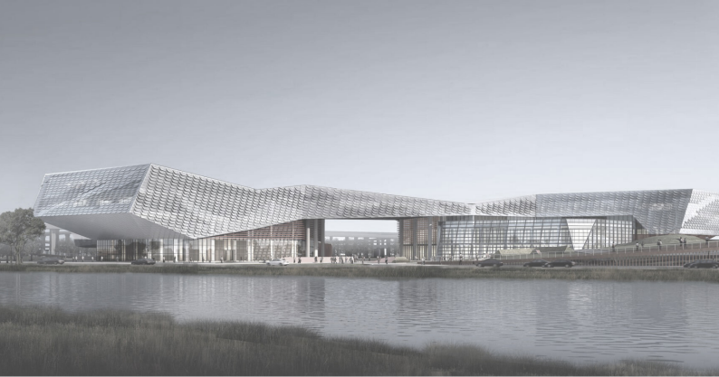
泰禾康 & 朴润中医馆
TAIHEKANG & PARKRUN
汇报人：武静
2026/07/02
ARCHITECTURE
PROPOSAL
837690
HTTP://ZYJZSJ. CN
FAX: 025 - 84540119 - 8019
E - MAIL:njzy sj@126 . com

Slide 2
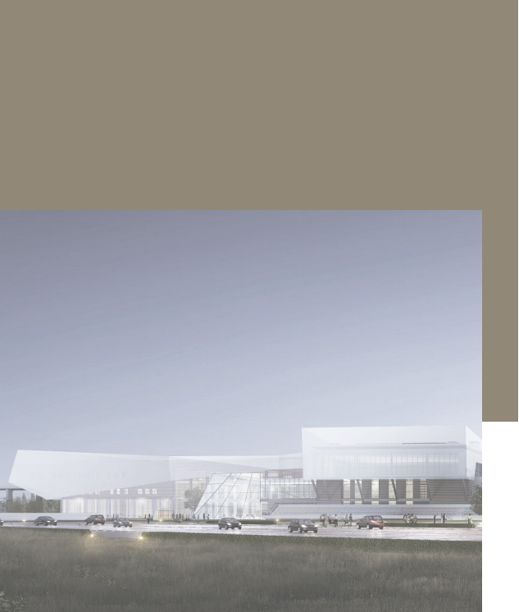
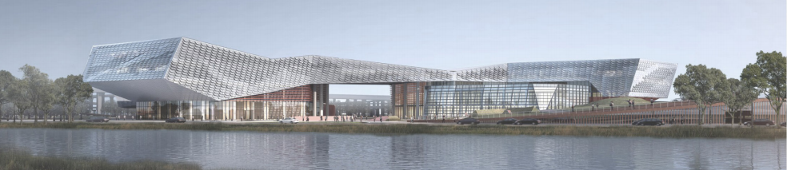
目 录
C O N T E N T
公司简介
INTRODUCTION
愿景 / 文化
OUR VISION/CULTURE
服务模式及范围
HOW IT WORKS&OUR SERVICES
我们的特点
OUR CHARACTERISTICS
我们的奖项
OUR ADWARDS
企业团队
COMPANY TEAM
项目案例
OUR PROJECT
数字化业务
DIGITAL BUSINESS
• 建筑行业（建筑工程）甲级资质
• 风景园林工程设计专项乙级
• 电力行业（送电工程、变电工程）专业丙级
• 人防工程乙级
• 公司成立于 1995 年
• 国家高新技术企业
• 建筑高新技术企业
• 风景园林高新技术企业
• 人防高新技术企业
• 送变电新技术企业

Slide 3


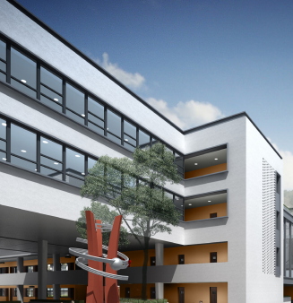
成为一家专业的，能为客户创造价值的，有影响力受尊重的设计咨询企业。
Become a professional, influential and respected design consulting company that can create value for customers.
愿景/文化
OUR VISION/ CULTURE
合作共赢，厚德载
物，自强不息。
Cooperate for win-win
results, carry virtue
and resources, and
constantly strive for
self-improvement.

Slide 4
成为一家专业的，能为客户创造价值的，有影响力受尊重的设计咨询企业。
Become a professional, influential and respected design consulting company that can create value for customers.
愿景/文化
OUR VISION/ CULTURE
合作共赢，厚德载
物，自强不息。
Cooperate for win-win
results, carry virtue
and resources, and
constantly strive for
self-improvement.

Slide 5

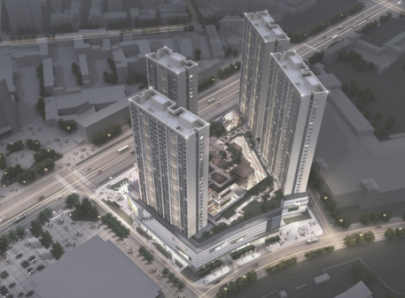
泰禾康
TAIHEKANG HEALTH MANAGEMENT
致力于在建设的细分领域形成集咨
询、规划、设计、实施、资本为一体的全产业链服务公司。
• 规划建筑设计
Planning and architectural design
• 电力设计
Electric power design
• 景观设计
Landscape design
• 装饰设计
Decorative design
• 商业策划与咨询
Business planning and consulting
• 工程技术开发咨询
Engineering technology development consulting
• 全过程工程咨询服务
Whole process engineering consulting services
• BIM技术 BIM technology
• EPC工程总承包 EPC
• 装配式建筑设计及深化设计
Assembled building design and deepening design
服务模式及范围
HOW IT WORKS&OUR SERVICES
为客户提供一站式、菜单式的专
家级服务。
Provide customers with one-stop,
menu-based expert services.
It is committed to forming a
full-industry chain service com- pany integrating consultation, planning, design, implementa- tion and capital in the construc- tion field.
HTTP://ZYJZSJ. CN

Slide 6
朴润中医馆
PARKRUN CHINESE MEDICINE
致力于在建设的细分领域形成集咨
询、规划、设计、实施、资本为一体的全产业链服务公司。
• 规划建筑设计
Planning and architectural design
• 电力设计
Electric power design
• 景观设计
Landscape design
• 装饰设计
Decorative design
• 商业策划与咨询
Business planning and consulting
• 工程技术开发咨询
Engineering technology development consulting
• 全过程工程咨询服务
Whole process engineering consulting services
• BIM技术 BIM technology
• EPC工程总承包 EPC
• 装配式建筑设计及深化设计
Assembled building design and deepening design
服务模式及范围
HOW IT WORKS&OUR SERVICES
为客户提供一站式、菜单式的专
家级服务。
Provide customers with one-stop,
menu-based expert services.
It is committed to forming a
full-industry chain service com- pany integrating consultation, planning, design, implementa- tion and capital in the construc- tion field.
HTTP://ZYJZSJ. CN

Slide 7
成为一家专业的，能为客户创造价值的，有影响力受尊重的设计咨询企业。
Become a professional, influential and respected design consulting company that can create value for customers.
愿景/文化
OUR VISION/ CULTURE
合作共赢，厚德载
物，自强不息。
Cooperate for win-win
results, carry virtue
and resources, and
constantly strive for
self-improvement.

Slide 8
鹿玮：运营总监
全球供应链专家，中医药出海领航
核心成员介绍
致力于在建设的细分领域形成集咨
询、规划、设计、实施、资本为一体的全产业链服务公司。
• 规划建筑设计
Planning and architectural design
• 电力设计
Electric power design
• 景观设计
Landscape design
• 装饰设计
Decorative design
• 商业策划与咨询
Business planning and consulting
• 工程技术开发咨询
Engineering technology development consulting
• 全过程工程咨询服务
Whole process engineering consulting services
• BIM技术 BIM technology
• EPC工程总承包 EPC
• 装配式建筑设计及深化设计
Assembled building design and deepening design
服务模式及范围
HOW IT WORKS&OUR SERVICES
为客户提供一站式、菜单式的专
家级服务。
Provide customers with one-stop,
menu-based expert services.
It is committed to forming a
full-industry chain service com- pany integrating consultation, planning, design, implementa- tion and capital in the construc- tion field.
HTTP://ZYJZSJ. CN

Slide 9
刘振伟：体系院长
资深养老专家，省级最美护理员
核心成员介绍
致力于在建设的细分领域形成集咨
询、规划、设计、实施、资本为一体的全产业链服务公司。
• 规划建筑设计
Planning and architectural design
• 电力设计
Electric power design
• 景观设计
Landscape design
• 装饰设计
Decorative design
• 商业策划与咨询
Business planning and consulting
• 工程技术开发咨询
Engineering technology development consulting
• 全过程工程咨询服务
Whole process engineering consulting services
• BIM技术 BIM technology
• EPC工程总承包 EPC
• 装配式建筑设计及深化设计
Assembled building design and deepening design
服务模式及范围
HOW IT WORKS&OUR SERVICES
为客户提供一站式、菜单式的专
家级服务。
Provide customers with one-stop,
menu-based expert services.
It is committed to forming a
full-industry chain service com- pany integrating consultation, planning, design, implementa- tion and capital in the construc- tion field.
HTTP://ZYJZSJ. CN

Slide 10
张华：中心总经理
10亿级爆品打造，大健康营销专家
核心成员介绍
致力于在建设的细分领域形成集咨
询、规划、设计、实施、资本为一体的全产业链服务公司。
• 规划建筑设计
Planning and architectural design
• 电力设计
Electric power design
• 景观设计
Landscape design
• 装饰设计
Decorative design
• 商业策划与咨询
Business planning and consulting
• 工程技术开发咨询
Engineering technology development consulting
• 全过程工程咨询服务
Whole process engineering consulting services
• BIM技术 BIM technology
• EPC工程总承包 EPC
• 装配式建筑设计及深化设计
Assembled building design and deepening design
服务模式及范围
HOW IT WORKS&OUR SERVICES
为客户提供一站式、菜单式的专
家级服务。
Provide customers with one-stop,
menu-based expert services.
It is committed to forming a
full-industry chain service com- pany integrating consultation, planning, design, implementa- tion and capital in the construc- tion field.
HTTP://ZYJZSJ. CN

Slide 11
宋美华：核心成员
丰富运营经验，卓越执行支撑
核心成员介绍
致力于在建设的细分领域形成集咨
询、规划、设计、实施、资本为一体的全产业链服务公司。
• 规划建筑设计
Planning and architectural design
• 电力设计
Electric power design
• 景观设计
Landscape design
• 装饰设计
Decorative design
• 商业策划与咨询
Business planning and consulting
• 工程技术开发咨询
Engineering technology development consulting
• 全过程工程咨询服务
Whole process engineering consulting services
• BIM技术 BIM technology
• EPC工程总承包 EPC
• 装配式建筑设计及深化设计
Assembled building design and deepening design
服务模式及范围
HOW IT WORKS&OUR SERVICES
为客户提供一站式、菜单式的专
家级服务。
Provide customers with one-stop,
menu-based expert services.
It is committed to forming a
full-industry chain service com- pany integrating consultation, planning, design, implementa- tion and capital in the construc- tion field.
HTTP://ZYJZSJ. CN

Slide 12
核心成员展示
致力于在建设的细分领域形成集咨
询、规划、设计、实施、资本为一体的全产业链服务公司。
• 规划建筑设计
Planning and architectural design
• 电力设计
Electric power design
• 景观设计
Landscape design
• 装饰设计
Decorative design
• 商业策划与咨询
Business planning and consulting
• 工程技术开发咨询
Engineering technology development consulting
• 全过程工程咨询服务
Whole process engineering consulting services
• BIM技术 BIM technology
• EPC工程总承包 EPC
• 装配式建筑设计及深化设计
Assembled building design and deepening design
服务模式及范围
HOW IT WORKS&OUR SERVICES
为客户提供一站式、菜单式的专
家级服务。
Provide customers with one-stop,
menu-based expert services.
It is committed to forming a
full-industry chain service com- pany integrating consultation, planning, design, implementa- tion and capital in the construc- tion field.
HTTP://ZYJZSJ. CN

Slide 13
成为一家专业的，能为客户创造价值的，有影响力受尊重的设计咨询企业。
Become a professional, influential and respected design consulting company that can create value for customers.
愿景/文化
OUR VISION/ CULTURE
合作共赢，厚德载
物，自强不息。
Cooperate for win-win
results, carry virtue
and resources, and
constantly strive for
self-improvement.

Slide 14
总体运营策略
致力于在建设的细分领域形成集咨
询、规划、设计、实施、资本为一体的全产业链服务公司。
• 规划建筑设计
Planning and architectural design
• 电力设计
Electric power design
• 景观设计
Landscape design
• 装饰设计
Decorative design
• 商业策划与咨询
Business planning and consulting
• 工程技术开发咨询
Engineering technology development consulting
• 全过程工程咨询服务
Whole process engineering consulting services
• BIM技术 BIM technology
• EPC工程总承包 EPC
• 装配式建筑设计及深化设计
Assembled building design and deepening design
服务模式及范围
HOW IT WORKS&OUR SERVICES
为客户提供一站式、菜单式的专
家级服务。
Provide customers with one-stop,
menu-based expert services.
It is committed to forming a
full-industry chain service com- pany integrating consultation, planning, design, implementa- tion and capital in the construc- tion field.
HTTP://ZYJZSJ. CN

Slide 15
血压健康：建立档案、定期监测
代谢管理：血糖血脂尿酸综合调理
围绝经期：女性更年期中医调理
前列腺专科：男性健康评估与理疗
• 生态建筑
ECOLOGICAL
• 景观建筑
LANDSCAPE
• 文体建筑
CULTURE AND SPORTS
• 商业建筑
COMMERCIAL
• 改造建筑
RENOVATION
• 乡村建筑
RURAL
• 室内建筑
INTERIOR
慢病管理中心

Slide 16
口腔专护：中医护齿、日常指导
睡眠管理：针灸推拿、行为干预
创面管理：专业护理、康复服务
• 生态建筑
ECOLOGICAL
• 景观建筑
LANDSCAPE
• 文体建筑
CULTURE AND SPORTS
• 商业建筑
COMMERCIAL
• 改造建筑
RENOVATION
• 乡村建筑
RURAL
• 室内建筑
INTERIOR
特色专科中心

Slide 17
运营总结：业务矩阵
致力于在建设的细分领域形成集咨
询、规划、设计、实施、资本为一体的全产业链服务公司。
• 规划建筑设计
Planning and architectural design
• 电力设计
Electric power design
• 景观设计
Landscape design
• 装饰设计
Decorative design
• 商业策划与咨询
Business planning and consulting
• 工程技术开发咨询
Engineering technology development consulting
• 全过程工程咨询服务
Whole process engineering consulting services
• BIM技术 BIM technology
• EPC工程总承包 EPC
• 装配式建筑设计及深化设计
Assembled building design and deepening design
服务模式及范围
HOW IT WORKS&OUR SERVICES
为客户提供一站式、菜单式的专
家级服务。
Provide customers with one-stop,
menu-based expert services.
It is committed to forming a
full-industry chain service com- pany integrating consultation, planning, design, implementa- tion and capital in the construc- tion field.
HTTP://ZYJZSJ. CN

Slide 18
成为一家专业的，能为客户创造价值的，有影响力受尊重的设计咨询企业。
Become a professional, influential and respected design consulting company that can create value for customers.
愿景/文化
OUR VISION/ CULTURE
合作共赢，厚德载
物，自强不息。
Cooperate for win-win
results, carry virtue
and resources, and
constantly strive for
self-improvement.

Slide 19
全面赋能，价值共创
致力于在建设的细分领域形成集咨
询、规划、设计、实施、资本为一体的全产业链服务公司。
• 规划建筑设计
Planning and architectural design
• 电力设计
Electric power design
• 景观设计
Landscape design
• 装饰设计
Decorative design
• 商业策划与咨询
Business planning and consulting
• 工程技术开发咨询
Engineering technology development consulting
• 全过程工程咨询服务
Whole process engineering consulting services
• BIM技术 BIM technology
• EPC工程总承包 EPC
• 装配式建筑设计及深化设计
Assembled building design and deepening design
服务模式及范围
HOW IT WORKS&OUR SERVICES
为客户提供一站式、菜单式的专
家级服务。
Provide customers with one-stop,
menu-based expert services.
It is committed to forming a
full-industry chain service com- pany integrating consultation, planning, design, implementa- tion and capital in the construc- tion field.
HTTP://ZYJZSJ. CN

Slide 20
收益模式
致力于在建设的细分领域形成集咨
询、规划、设计、实施、资本为一体的全产业链服务公司。
• 规划建筑设计
Planning and architectural design
• 电力设计
Electric power design
• 景观设计
Landscape design
• 装饰设计
Decorative design
• 商业策划与咨询
Business planning and consulting
• 工程技术开发咨询
Engineering technology development consulting
• 全过程工程咨询服务
Whole process engineering consulting services
• BIM技术 BIM technology
• EPC工程总承包 EPC
• 装配式建筑设计及深化设计
Assembled building design and deepening design
服务模式及范围
HOW IT WORKS&OUR SERVICES
为客户提供一站式、菜单式的专
家级服务。
Provide customers with one-stop,
menu-based expert services.
It is committed to forming a
full-industry chain service com- pany integrating consultation, planning, design, implementa- tion and capital in the construc- tion field.
HTTP://ZYJZSJ. CN

Slide 21

感谢观看
携手共进，共创辉煌
LINGJIAOSHI66,GUOCHUANGYUAN8-B
025 - 84540119 - 8019
www.ZYJZSJ.CN

